Slide 1
Stereo Visual Odometry
Chirayu Garg
Utkarsh jain

Slide 2
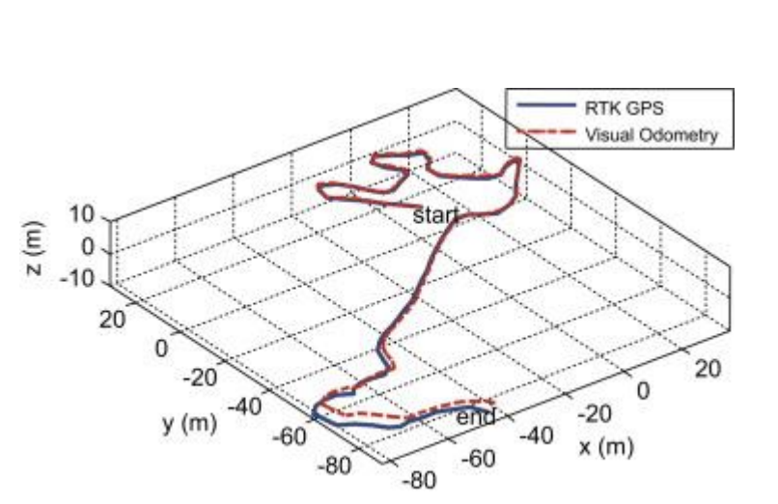
What is Visual Odometry?
Visual Odometry is the estimating the motion of a camera in real time using sequential images
The idea was first introduced for planetary rovers operating on Mars – Moravec 1980
6-DOF of the robot
Euler Angles
Cartesian Coordinates

Slide 3
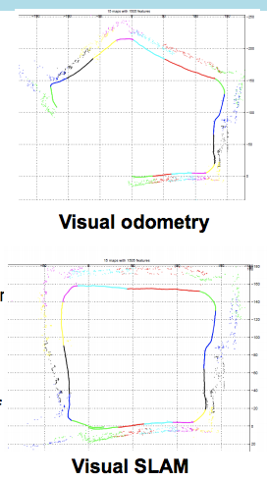
VSLAM
Simultaneous Localization and Mapping
The goal of SLAM is to obtain a global, consistent estimate of the camera's path
Visual Odometry is used as a building block of SLAM
SLAM finds loop closures in the paths generated by Visual Odometry and adjusts the drifts in the path

Slide 4
Applications of Visual Odometry
Movement prediction in uneven terrains
Motion estimation for vehicles
HD mapping
Autonomous cars
Possible use in AR/VR applications
Challenges
Robustness to lighting conditions
Lack of features / non-overlapping images
Without loop closure the estimate still drifts
Notes:
Contrary to wheel odometry, Visual Odometry is not affected by wheel slip in uneven terrain or other adverse conditions.

Slide 5
Types of Visual Odometry
Stereo Visual Odometry
Solves the scale problem
Feature depth between images
Degenerates to the monocular case if only distant features are used
Monocular Visual Odometry
A single camera = angle sensor
Motion scale is unobservable (it must be synthesized)
Best used in hybrid methods

Slide 6
Augmented Stereo Visual Odometry
Lidar
Time-of-flight
RGB-Depth
GPS
*Image - https://www.wired.com/2015/04/cost-of-sensors-autonomous-cars/

Slide 7
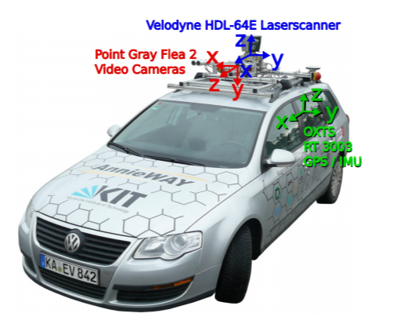
The Dataset
KITTI Vision Benchmark Suite dataset by KIT, Germany
Grayscale and color image data, with LIDAR laser data
Undistorted and stereo rectified
W x H – 1241 x 376
Calibration camera projection matrices are provided
The output poses for each frame are with respect to the 0th image in the sequence
Notes:
Stereo rectification: Apply projective transformation so that epipolar lines correspond to horizontal scanlines

Slide 8
Algorithm
Real-Time Stereo Visual Odometry for Autonomous Ground Vehicles by Andrew Howard, IEEE 2008
Image Sequence
Feature Detection
Feature Matching
3D point cloud generation
Inlier Detection
Motion Estimation

Slide 9
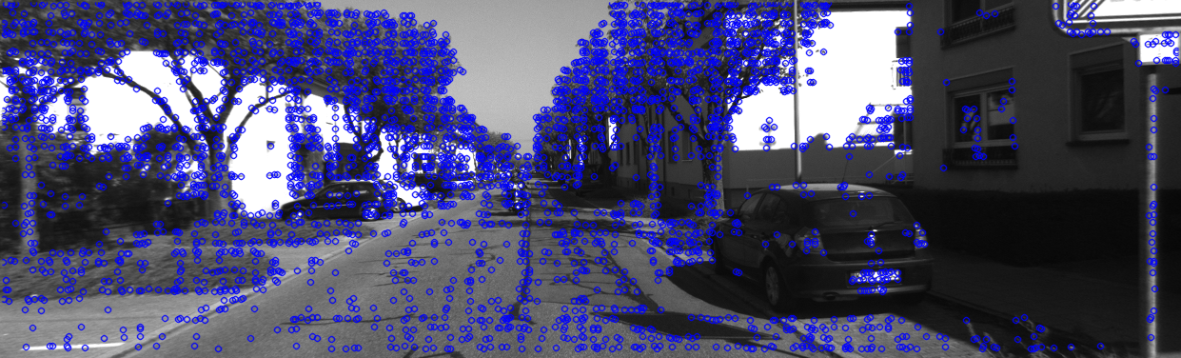
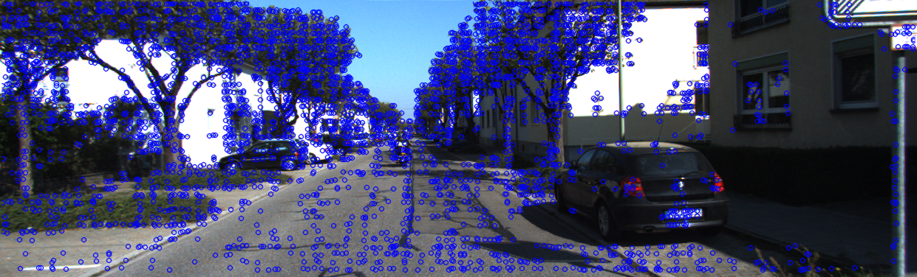
Feature Detection
FAST (Features from Accelerated Segment Test) corner detection
Feature Bucketing
Disparity computation from Stereo images

Slide 10
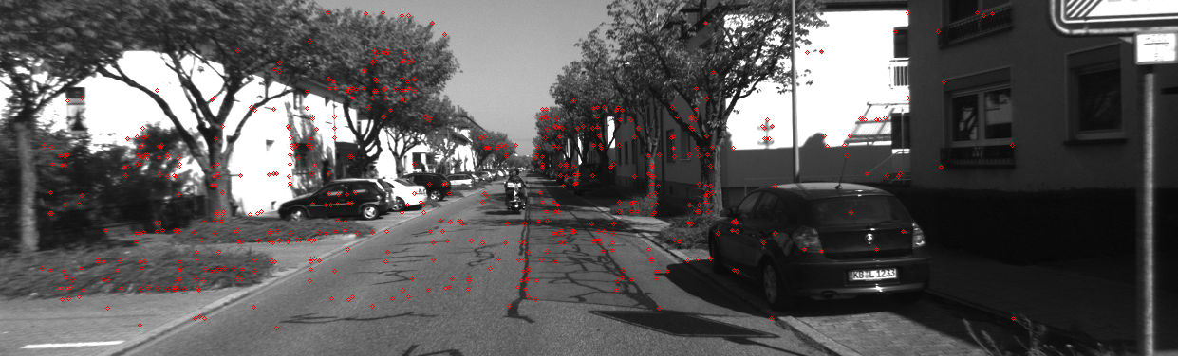
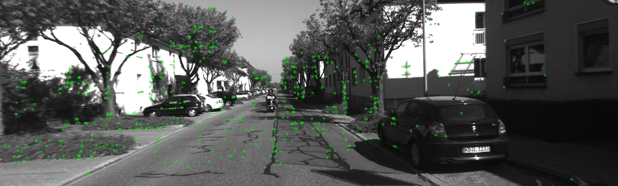
Feature Matching
KLT Tracker is used to find corresponding feature points at T+1
Search Window – 15x15
Pyramid Level – 3
Feature points pruning
Notes:
KLT tracker is used for finding corresponding points, instead of feature descriptor computation for both images and comparing features for matching
Point pruning – KLT rejected, KLT error, out of target bounds

Slide 11
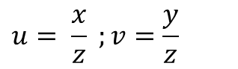
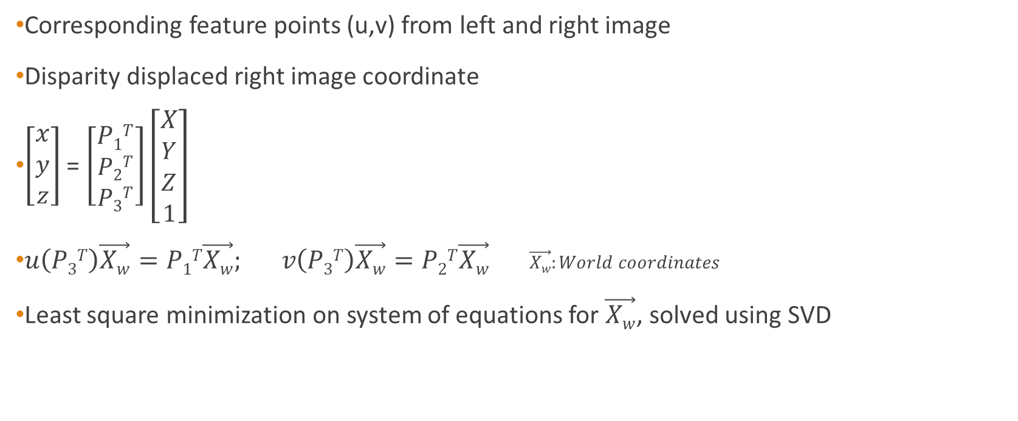
3D Point Triangulation
Corresponding feature points (u,v) from left and right image
Disparity displaced right image coordinate
$\left[\begin{aligned}x \\ y \\ z\end{aligned}\right]$ = $\left[\begin{aligned}P1T \\ P2T \\ P3T\end{aligned}\right]\left[\begin{aligned}X \\ Y \\ Z \\ 1\end{aligned}\right]$
$u\left(P3T\right)\vec{Xw}=P1T\vec{Xw}; v\left(P3T\right)\vec{Xw}=P2T\vec{Xw}$ $\vec{Xw}:World coordinates$
Least square minimization on system of equations for $\vec{Xw}$, solved using SVD
$$u= \frac{x}{z} ;v=\frac{y}{z}$$

Slide 12
Inlier detection
Clique building on consistent 3D points with same distance at time T and T+1
Grow clique with connected points
d
j
j
i
d
i
T
T+1

Slide 13
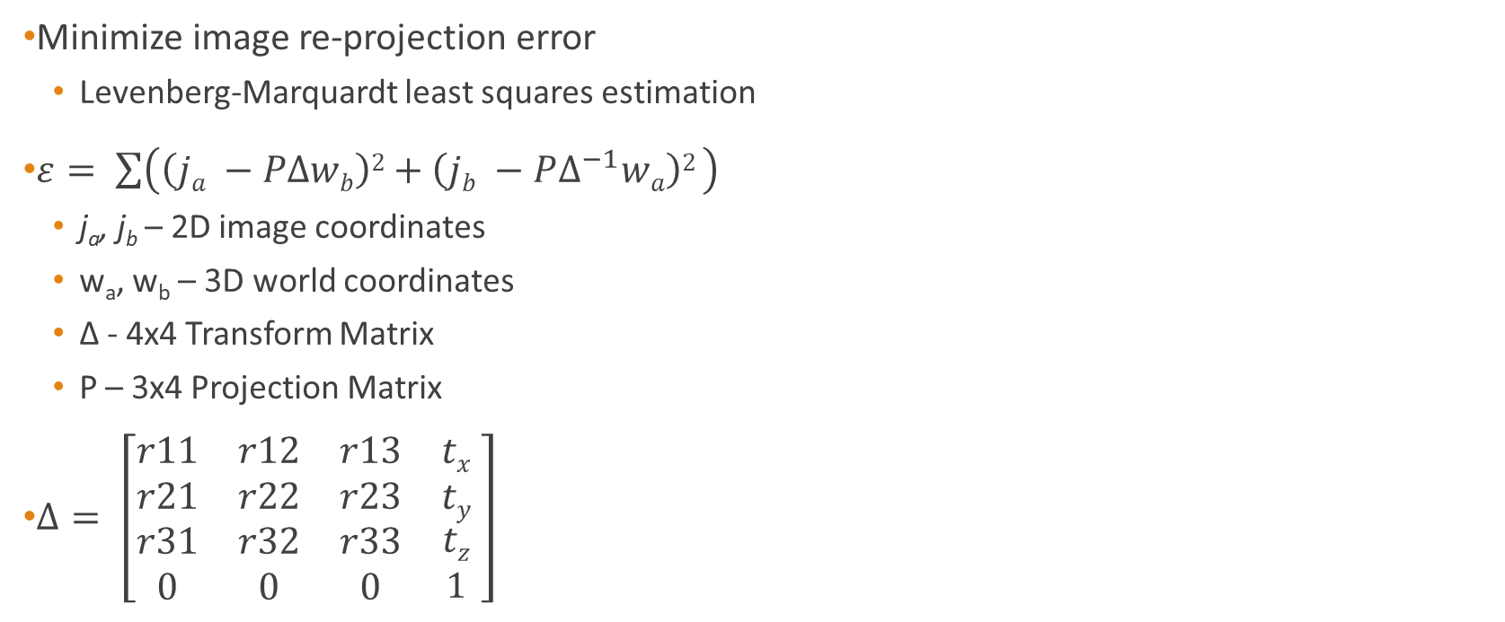
Motion Estimation
Minimize image re-projection error
Levenberg-Marquardt least squares estimation
$ε= \sum{\left(\left(ja −PΔwb\right)2+\left(jb −PΔ^{−1}wa\right)2 \right)}$
j_{a}, j_{b} – 2D image coordinates
w_{a}, w_{b} – 3D world coordinates
Δ - 4x4 Transform Matrix
P – 3x4 Projection Matrix
$Δ= \left[\begin{matrix}r11 & r12 & r13 & tx \\ r21 & r22 & r23 & ty \\ \begin{aligned}r31 \\ 0\end{aligned} & \begin{aligned}r32 \\ 0\end{aligned} & \begin{aligned}r33 \\ 0\end{aligned} & \begin{aligned}tz \\ 1\end{aligned}\end{matrix} \right]$
W_{a}
W_{b}
j_{a}
j_{b}
T
T+1
Δ

Slide 14
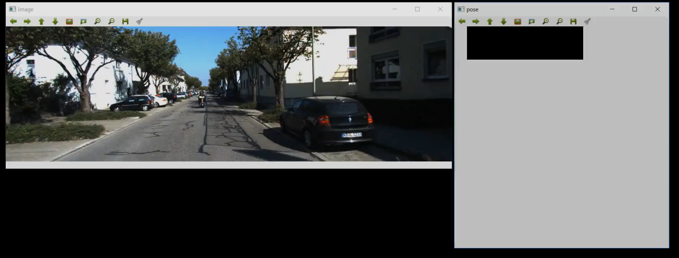
Demo

Slide 15
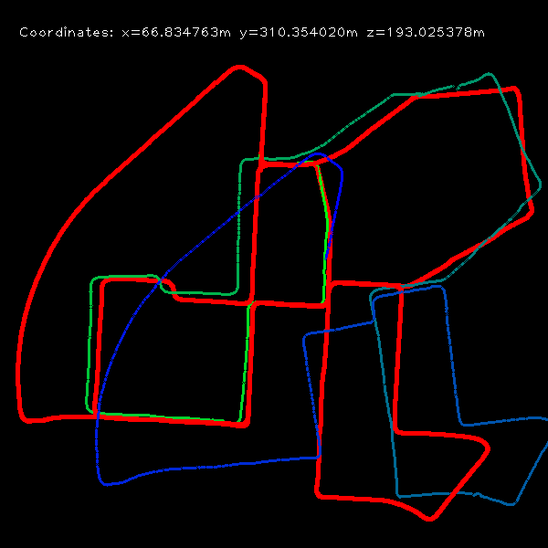
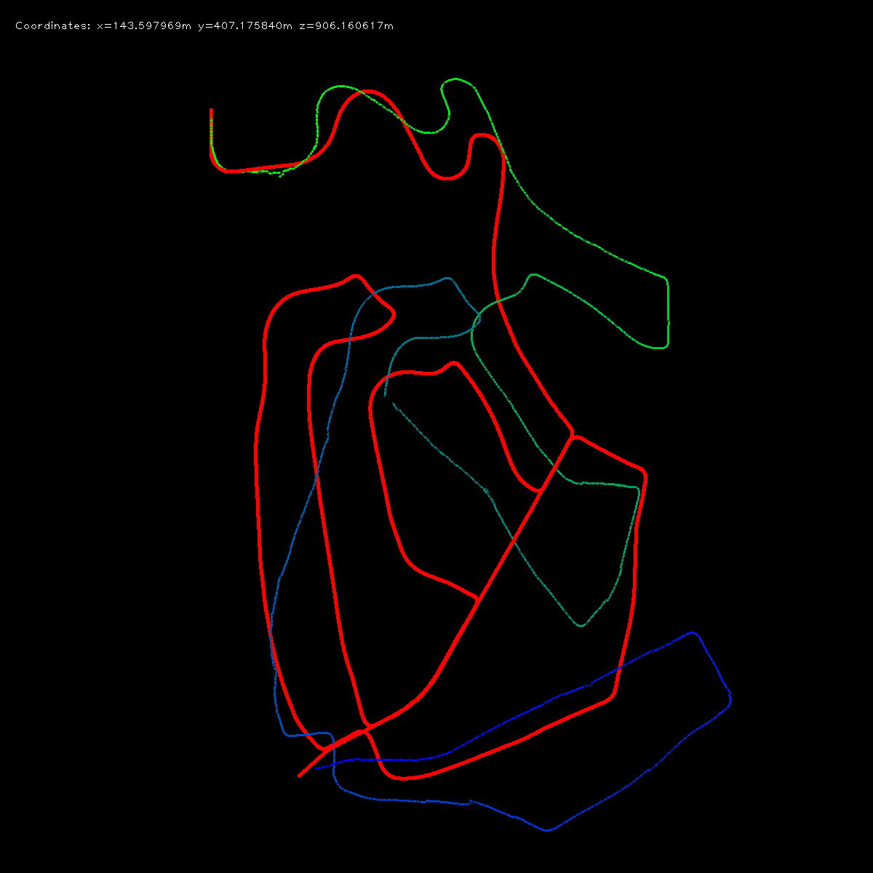
Results
Ground Truth
Seq 00
Seq 02
SVO

Slide 16
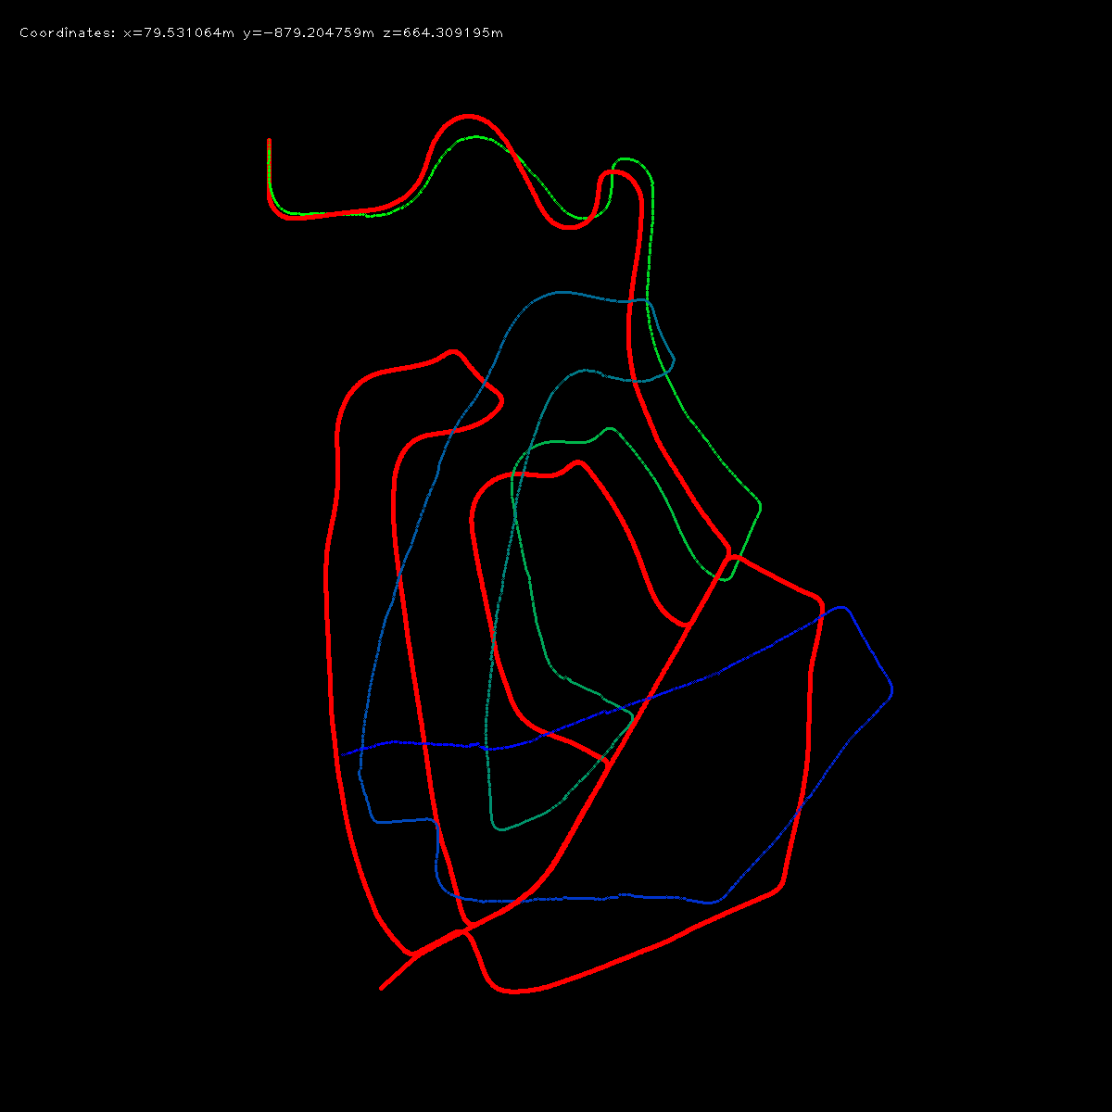
Results: FAST vs SIFT
Ground Truth
Seq 02
FAST
Seq 02
SIFT
SVO

Slide 17
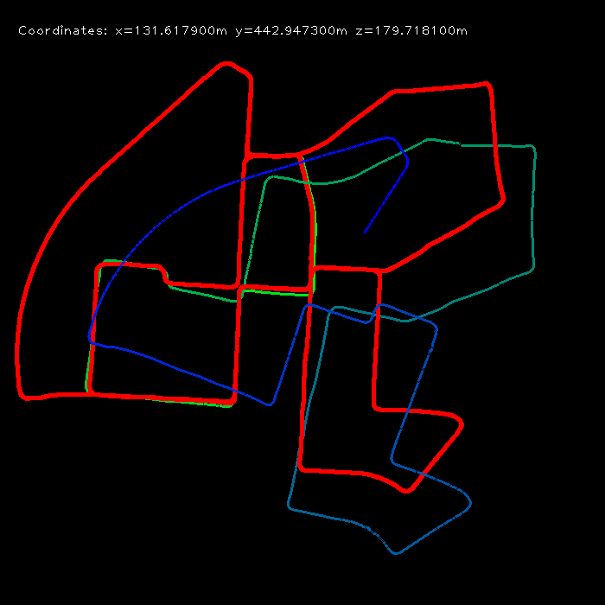
Results: Clique vs RANSAC
Ground Truth
FAST
SIFT
SVO
Seq 00
Clique
Seq 00
RANSAC

Slide 18
Tunable Parameters
Disparity computation – block size, number of disparities
KLT tracker – block size, image scale (pyramid)
KLT error threshold
Clique consistent point difference threshold
Re-projection error threshold

Slide 19
Future Work
Brightness invariant feature tracking
Neural network for feature matching - Universal Correspondence Network
Faster inlier detection
Integration of other sensor data

Slide 20
References
[1] A. Howard. Real-time stereo visual odometry for autonomous ground vehicles. In IEEE Int.
Conf. on Intelligent Robots and Systems , Sep 2008
[2] C. B. Choy, J. Gwak, S. Savarese and M. Chandraker. Universal Correspondence Network.
NIPS , 2016
[3] http://www.cvlibs.net/datasets/kitti/eval_odometry.php

